Slide 1



Optimal Scheduling of Plugin Electric Vehicles Considering Seasonal Uncertainty
PROJECT MEMBERS:
SHRUTI MODI(12021002011038)
RUPALI DUTTA(12021002011050)
SOUMYADEEP BERA(12021002011001)
Under the supervision of
Prof. (Dr.) Sourav Das
Assistant Professor
Department of Electrical Engineering,
IEM Kolkata
1

Slide 2
INTRODUCTION
Global warming is a significant issue today, largely driven by air pollution.
A major contributor to air pollution is the use of internal combustion engine (ICE) vehicles.
As a result, the electrification of automobiles has become a popular solution.
However, while electric vehicles (EVs) are gaining popularity, the number of charging stations is still limited, and the demand for electricity is high.
So we have tried to analyse different charging strategies (considering G2V and V2G) for vehicles such that the owner of the grid as well as the owner of the vehicle can benefit from it.
Along with this, we have studied different driving cycle pattern in different seasons and used it for scheduling.
2

Slide 3
Literature Gap
From [2], we observed that technical feasibility of V2G has been studied without considering the economic impacts
From [4], we see there is lack of comprehensive strategies for managing both V2G and G2V simultaneously.
In [12], the authors did not consider dynamic electric pricing for developing scheduling algorithm.
In [13-14] uncertainty related to EV driving cycles and battery degradation cost has not been considered for scheduling.
3

Slide 4
Objectives
To minimize the total cost of charging by considering the uncertainty in EV driving cycles.
To analyse the charging behaviour of G2V & V2G mode of operation considering seasonal uncertainty.
4

Slide 5
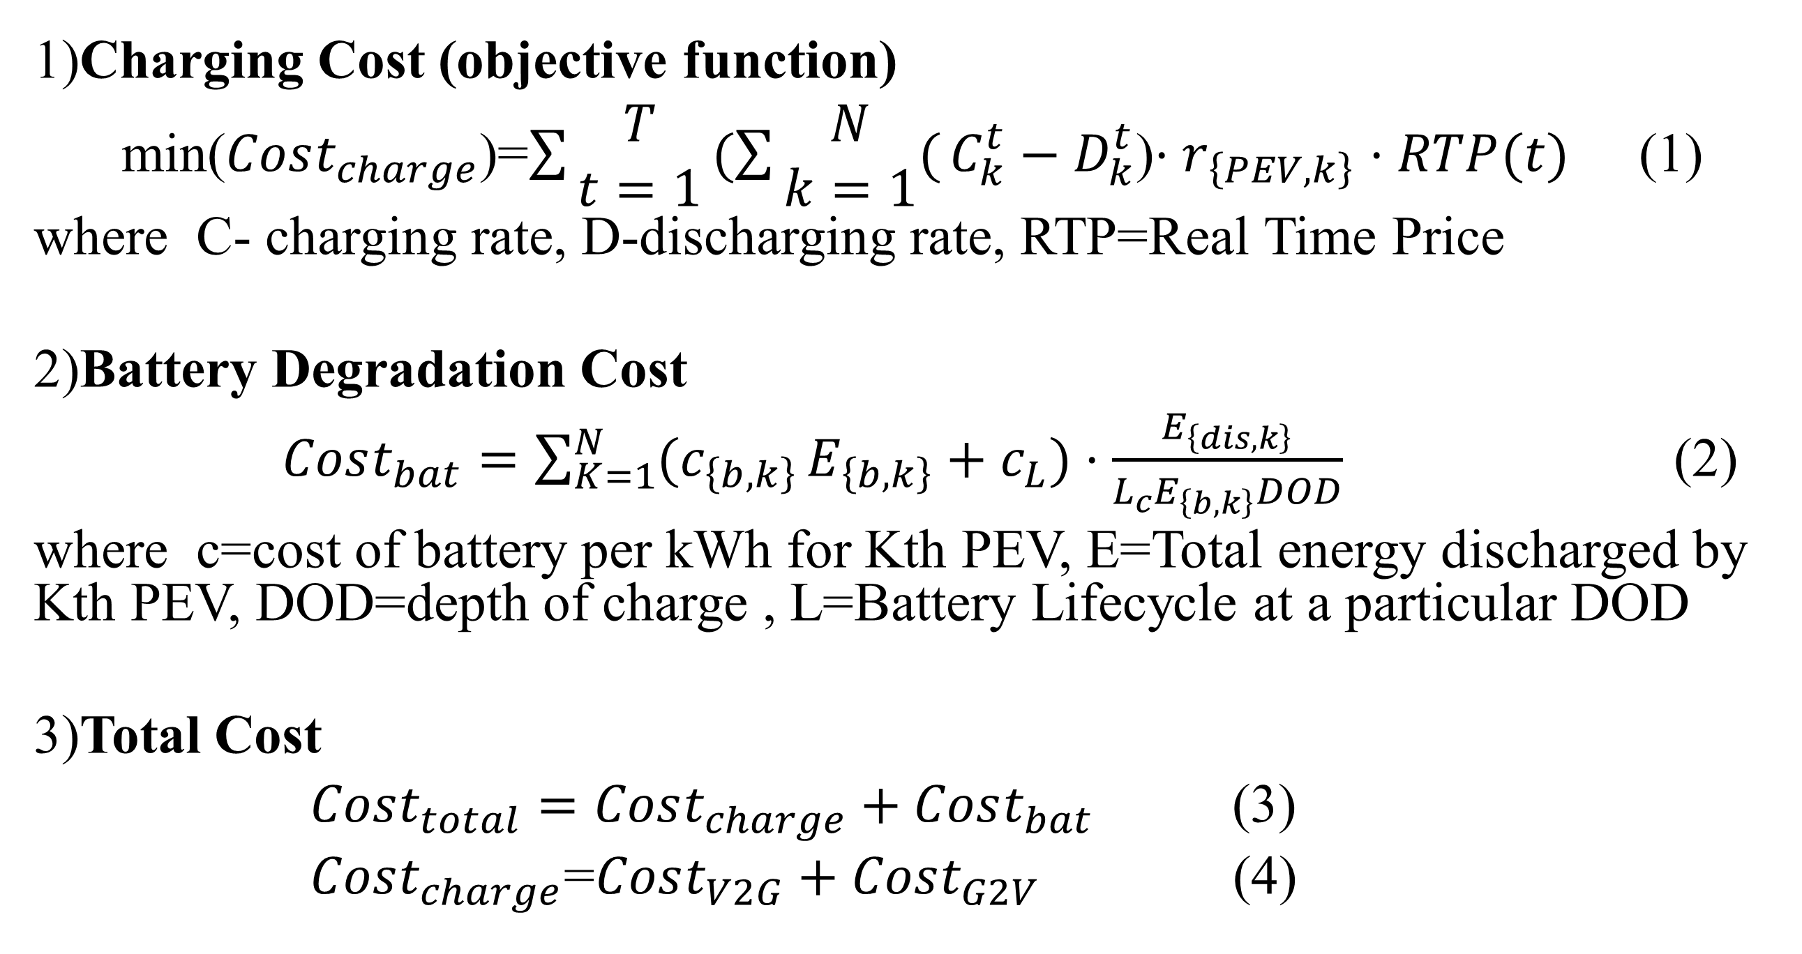
Problem Formulation
1)Charging Cost (objective function)
min($Cost_{charge}$)=$\sum{\begin{aligned}T \\ t=1\end{aligned}}(\sum{\begin{aligned}N \\ k=1\end{aligned}(}C_{k}^{t}−D_{k}^{t}$)$⋅r_{\left\{PEV,k\right\}}$ $⋅RTP(t)$ (1)
where C- charging rate, D-discharging rate, RTP=Real Time Price
2)Battery Degradation Cost
$Cost_{bat}=\sum_{K=1}^{N}{{(c}_{\left\{b,k\right\}}}E_{\left\{b,k\right\}}+c_{L})⋅\frac{E_{\left\{dis,k\right\}}}{L_{c}E_{\left\{b,k\right\}}DOD}$ (2)
where c=cost of battery per kWh for Kth PEV, E=Total energy discharged by Kth PEV, DOD=depth of charge , L=Battery Lifecycle at a particular DOD
3)Total Cost
$Cost_{total}=Cost_{charge}+Cost_{bat}$ (3)
$Cost_{charge}$=$Cost_{V2G}+Cost_{G2V}$ (4)

Slide 6
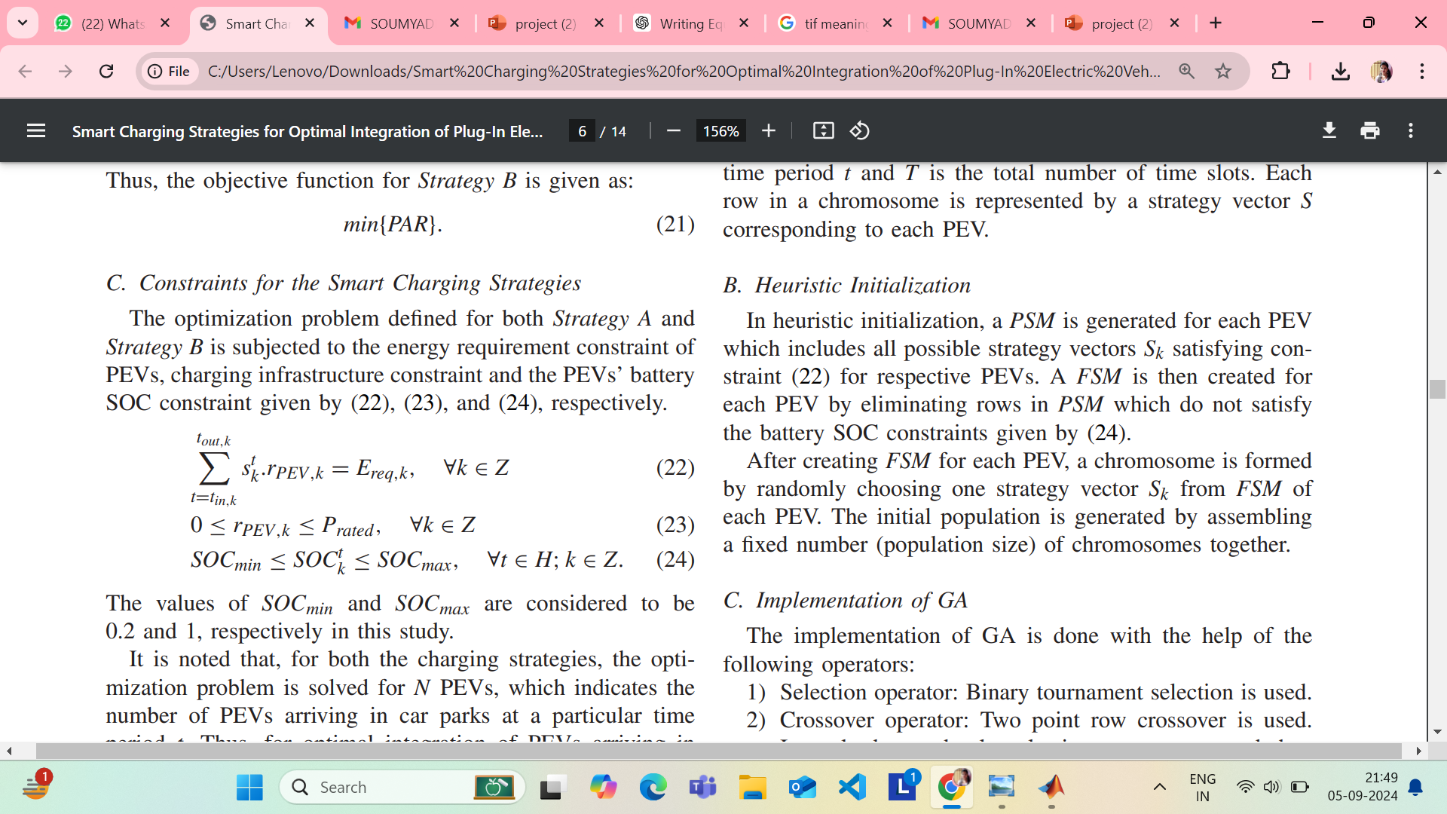
Constraints
Battery Constraints:
Battery State of Charge (SOC) must be within limits:
Power Constraints:
Charging power cannot exceed the maximum rated power for the charging station.
Seasonal Driving Pattern Constraints:
Distance and energy consumption are constrained based on seasonal driving patterns (e.g., higher consumption in winter due to heating).
Grid Constraints:
Ensure that the grid load remains within safe operational limits to avoid overloading during peak hours.

Slide 7
INPUT DATA
(ALL THE DRIVING CYCLES FOLLOW NORMAL DISTRIBUTION[2])
1. Test Case I:
Scheduling with more higher battery capacity(HBC).
(BEV= 50%, PHEV 40=30%, PHEV 30=20%)
2. Test Case 2:
Scheduling with more lower battery capacity(LBC).
(BEV=20%, PHEV 40=30%, PHEV 30=50%)
THE DYNAMIC TARIFF IS FETCHED FROM [1], where 30 mins intervals the price is changing
Tariff (s$ / MWhr)
Time Slots
7

Slide 8
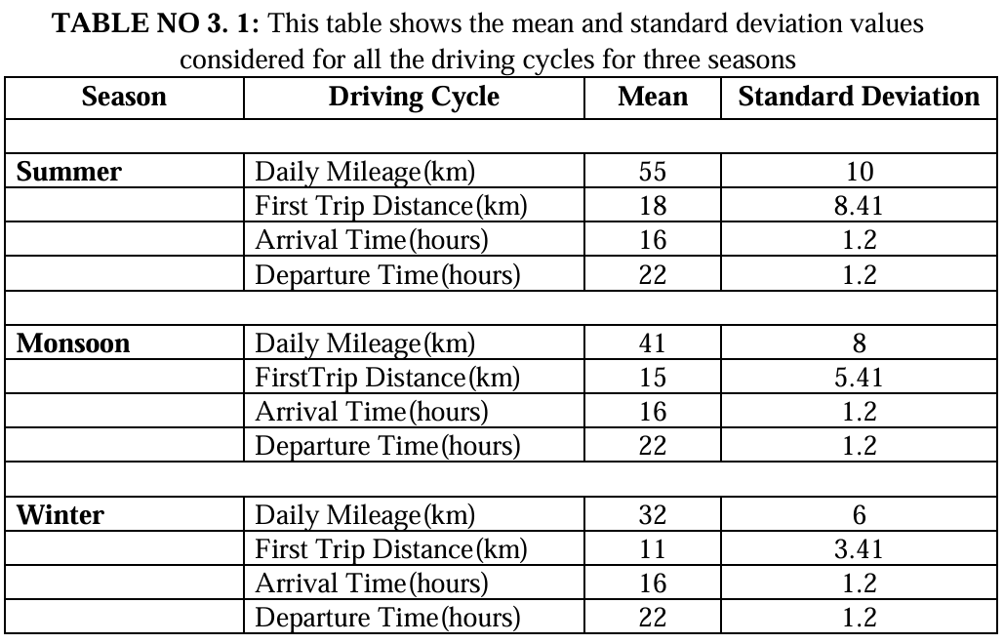

Slide 9
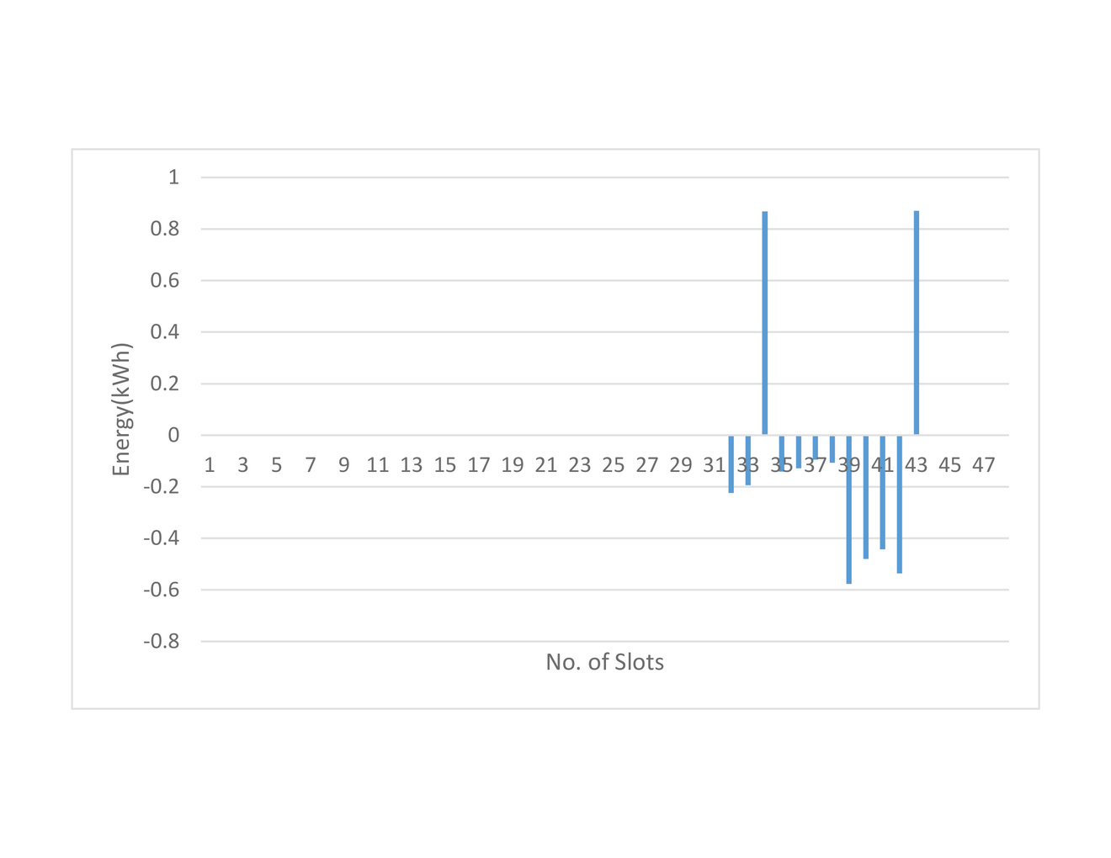
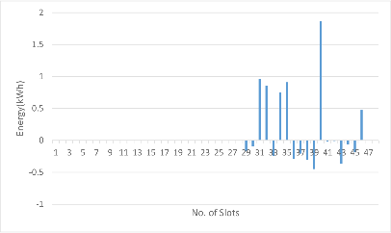
3.6.1 For Summer: | 3.6.1 For Summer:
High Battery Capacity (HBC)
Fig. 1a. Energy Exchange of HBC set of vehicles for 48 slots | Here we can see the energy exchange between grid and vehicle for 48 slots during summer. The vehicles are undergoing more V2G(discharging) than G2V(charging) even when the tariff rate is high (as we can see from 3.5)
Low Battery Capacity (LBC) | Low Battery Capacity (LBC)
Fig. 1b. Energy Exchange of HBC set of vehicles for 48 slots | Here we can see the energy exchange between grid and vehicle for 48 slots for LBC during summer. The vehicles are undergoing more G2V(charging) than V2G(discharging).
9

Slide 10
High Battery Capacity (HBC)
Fig. 2a.. Charging Strategy for HBC set of vehicles considering G2V + V2G | In this charging strategy we can see white spaces are more which shows discharging and the dark blue spaces are less which shows charging.
Low Battery Capacity (LBC)
Fig. 2b. Charging Strategy for LBC set of vehicles considering G2V + V2G | In this charging strategy we can see dark blue spaces are more which shows charging and the white spaces are less which shows discharging.
10

Slide 11
High Battery Capacity (HBC) | High Battery Capacity (HBC)
Fig. 3a. Energy Requirement Fulfilment of HBC set of vehicles | We can see from the figure that the energy required by the vehicles has been completely fulfilled with the charging strategies developed for HBC during summer. Even after participating in V2G mode of operation.
Low Battery Capacity (LBC) | Low Battery Capacity (LBC)
Fig. 3b. Energy Requirement Fulfilment of LBC set of vehicles | We can see from the figure that the energy required by the vehicles has been completely fulfilled with the charging strategies developed for LBC during summer.
11

Slide 12
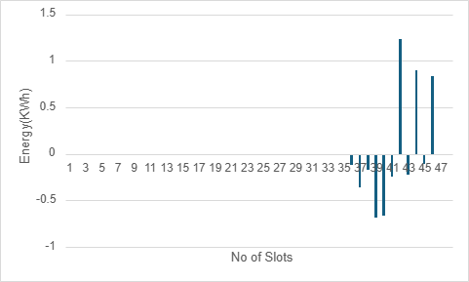
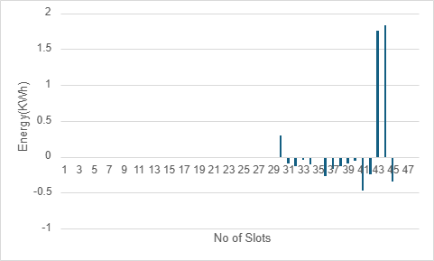
3.6.2 For Monsoon | 3.6.2 For Monsoon
High Battery Capacity (HBC) | High Battery Capacity (HBC)
Fig. 1a. Energy Exchange of HBC set of vehicles for 48 slots | Here we can see the energy exchange between grid and vehicle for 48 slots during monsoon. The vehicles are undergoing more V2G(discharging) than G2V(charging)
Low Battery Capacity (LBC) | Low Battery Capacity (LBC)
Fig. 1b. Energy Exchange of LBC set of vehicles for 48 slots. | Here we can see the energy exchange between grid and vehicle for 48 slots for LBC during monsoon. The vehicles are undergoing more G2V(charging) than V2G(discharging).
12

Slide 13
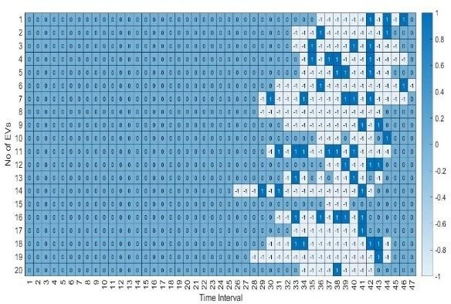
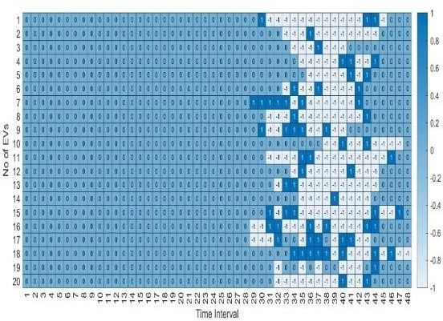
High Battery Capacity (HBC) | High Battery Capacity (HBC)
Fig. 2a. Charging Strategy for HBC set of vehicles considering G2V + V2G | In this charging strategy we can see white spaces are more which shows discharging and the dark blue spaces are less which shows charging.
Low Battery Capacity (LBC)
Fig. 2b. Charging Strategy for LBC set of vehicles considering G2V + V2G | In this charging strategy we can see dark blue spaces are more which shows charging and the white spaces are less which shows discharging
13

Slide 14
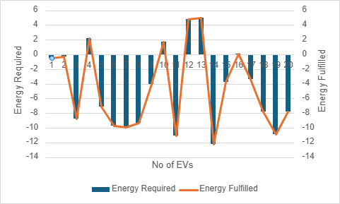
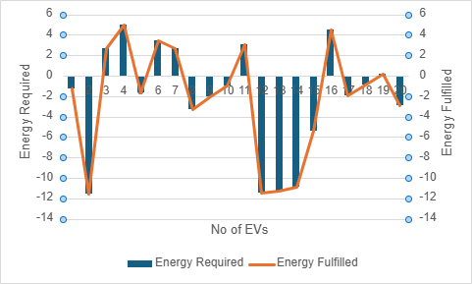
High Battery Capacity (HBC) | High Battery Capacity (HBC)
Fig. 3a. Energy Requirement Fulfilment of HBC set of vehicles | We can see from the figure that the energy required by the vehicles has been completely fulfilled with the charging strategies developed for HBC during monsoon.
Low Battery Capacity (LBC) | Low Battery Capacity (LBC)
Fig.3b.Energy Requirement Fulfilment of LBC set of Vehicles | We can see from the figure that the energy required by the vehicles has been completely fulfilled with the charging strategies developed for LBC during monsoon.
14

Slide 15
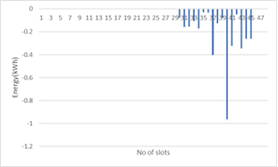
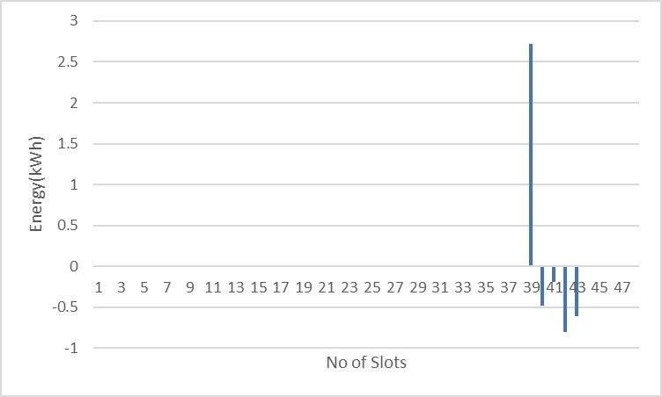
3.6.2 For Winter | 3.6.2 For Winter
High Battery Capacity (HBC) | High Battery Capacity (HBC)
Fig. 1a.. Energy Exchange of HBC set of vehicles for 48 slots. | Here we can see the energy exchange between grid and vehicle for 48 slots during winter. The vehicles are undergoing more V2G(discharging) than G2V(charging) even when the tariff rate is high (as we can see from fig 3.5)
Low Battery Capacity (LBC)
Fig. 1b. Energy Exchange of LBC set of vehicles for 48 slots | Here we can see the energy exchange between grid and vehicle for 48 slots for LBC during winter. The vehicles are undergoing more G2V(charging) than V2G(discharging).
15

Slide 16
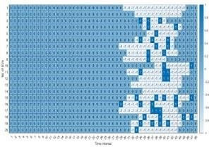
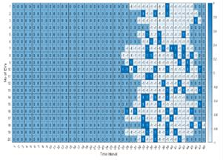
High Battery Capacity (HBC) | High Battery Capacity (HBC)
Fig. 2a. Charging Strategy for HBC set of vehicles considering G2V + V2G | In this charging strategy we can see white spaces are more which shows discharging and the dark blue spaces are less which shows charging.
Low Battery Capacity (LBC) | Low Battery Capacity (LBC)
Fig. 2b. Charging Strategy for LBC set of vehicles considering G2V + V2G | In this charging strategy we can see dark blue spaces are more which shows charging and the white spaces are less which shows discharging
16

Slide 17
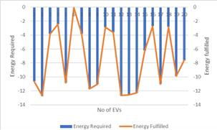
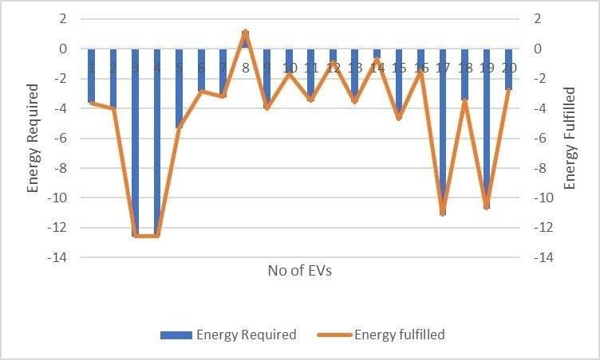
High Battery Capacity (HBC)
Fig. 3a. Energy Requirement Fulfilment of HBC set of vehicles | We can see from the figure that the energy required by the vehicles has been completely fulfilled with the charging strategies developed for HBC during winter.
Low Battery Capacity (LBC) | High Battery Capacity (HBC)
Fig. 3b. Energy Requirement Fulfillment of LBC set of vehicles | We can see from the figure that the energy required by the vehicles has been completely fulfilled with the charging strategies developed for LBC during winter.
17

Slide 18
Cost Comparison:
Seasons | Cost for HBC EV Charging(s$) | Cost for LBC EV Charging(s$)
Summer | -1.3511 | 2.2226
Monsoon | -1.2108 | 0.1271
Winter | -3.5168 | 1.366
From the data provided, we can observe that profit has been made in all three seasons for HBC, as the negative values indicate greater vehicle-to-grid (V2G) activity, resulting in profit. Among the seasons, the maximum profit is observed in winter, with a value of -3.5168, indicating the highest V2G activity compared to summer and monsoon.
Comparison (from graphs)
From the above graphs we can observe the vehicle undergoes maximum discharging in case of HBC even when we have higher tariff rates
Secondly among three seasons, maximum V2G is seen in case of winter, followed by monsoon and summer.
18

Slide 19
Conclusion:
This project presents a comprehensive approach to optimize the allocation and scheduling of electric vehicle (EV) charging, considering the techno-economic perspectives of grid-to-vehicle (G2V) and vehicle-to-grid (V2G) operations. Through the analysis of seasonal driving patterns and addresses the challenges of uncontrolled EV charging, grid instability and battery degradation.
The following key conclusions can be draw:
Seasonal variations significantly influence EV driving patterns and energy consumption, necessitating adaptive charging schedules for summer, monsoon, and winter scenarios.
Optimized Scheduling: The proposed scheduling framework successfully minimizes charging costs while ensuring grid stability, especially under dynamic electricity pricing.
Integrating battery degradation costs into the model ensures longer battery life, reducing overall costs for EV owners.
When the EVs are having high battery capacity , they tends to participate more in V2G mode of operation.
By addressing these challenges, this project provides a pathway for efficient EV integration into existing power systems , supporting both energy providers and users in the transition toward sustainable mobility.
19

Slide 20
Future Scope
Future research will focus on optimizing the placement of charging stations in distribution systems while ensuring smart charging schedules that minimize energy losses, enhance load balancing, and accommodate the integration of renewable energy sources.
20

Slide 21
Publication
[1] Das S, Modi S, Bera S and Dutta R, 2024. Optimal Scheduling of Plugin Electric Vehicles Considering Seasonal Uncertainty. IEMRE 2024, Springer (accepted).

Slide 22
Reference
[1] Fokui, W.S.T., Saulo, M.J. and Ngoo, L., 2021. Optimal placement of electric vehicle charging stations in a distribution network with randomly distributed rooftop photovoltaic systems. Ieee Access, 9, pp.132397-132411.
[2] C. Liu, K. T. Chau, D. Wu, and S. Gao, “Opportunities and challenges of vehicle-to-home, vehicle-to-vehicle, and vehicle-to-grid technologies,” Proc. IEEE, vol. 101, no. 11, pp. 2409–2427, Nov. 2013.
[3] Unterluggauer, T., Rich, J., Andersen, P.B. and Hashemi, S., 2022. Electric vehicle charging infrastructure planning for integrated transportation and power distribution networks: A review. ETransportation, 12, p.100163.
[4] M. Yilmaz and P. T. Krein, “Review of the impact of vehicle-to-grid technologies on distribution systems and utility interfaces,” IEEE Trans. Power Electron., vol. 28, no. 12, pp. 5673–5689, Dec. 2013
[5] Sadhukhan, A., Ahmad, M.S. and Sivasubramani, S., 2021. Optimal allocation of EV charging stations in a radial distribution network using probabilistic load modeling. IEEE Transactions on Intelligent Transportation Systems, 23(8), pp.11376-11385.
[6] Yu, Z., Wu, Z., Li, Q. and Bai, Q., 2022. A map matching-based method for electric vehicle charging station placement at directional road segment level. Sustainable Cities and Society, 84, p.103987.
[7] W. Kempton and J. Tomic, “Vehicle-to-grid power implementation: From ´ stabilizing the grid to supporting large-scale renewable energy,” J. Power Sources, vol. 144, no. 1, pp. 280–294, 200
8
21
Notes:
21

Slide 23
[8] Yazdekhasti, A., Jazi, M.A. and Ma, J., 2021. Electric vehicle charging station location determination with consideration of routing selection policies and driver’s risk preference. Computers & Industrial Engineering, 162, p.107674.
[9] Sadhukhan, A., Ahmad, M.S. and Sivasubramani, S., 2021. Optimal allocation of EV charging stations in a radial distribution network using probabilistic load modeling. IEEE Transactions on Intelligent Transportation Systems, 23(8), pp.11376-11385.
[10] Long, Y., Li, Y., Wang, Y., Cao, Y., Jiang, L., Zhou, Y., Deng, Y. and Nakanishi, Y., 2021. Impact of EV load uncertainty on optimal planning for electric vehicle charging station. Science China Technological Sciences, 64, pp.2469-2476.
[12] J. Huang, V. Gupta, and Y. F. Huang, “Scheduling algorithms for PHEV charging in shared parking lots,” in Proc. Amer. Control Conf. (ACC), Montreal, QC, Canada, 2012, pp. 276–281
[13] L. Jian, Y. Zheng, X. Xiao, and C. C. Chan, “Optimal scheduling for vehicle-to-grid operation with stochastic connection of plug-in electric vehicles to smart grid,” Appl. Energy, vol. 146, pp. 150–161, May 2015
[14] R. Storn and K. Price, “Differential Evolution – A Simple and Efficient Heuristic for Global Optimization over Continuous Spaces,” Journal of Global Optimization, vol. 11, no. 4, pp. 341–359, 1997.
[15] J. Smith et al., “Multiobjective Differential Evolution With Speciation for Constrained Multimodal Multiobjective Optimization,” IEEE Transactions on Evolutionary Computation, vol. 27, no. 2, pp. 150–161, Feb. 2024.
8
22
Notes:
22

Slide 24
THANK YOU
23

